Slide 1
Team Introductions & Goals

Slide 2
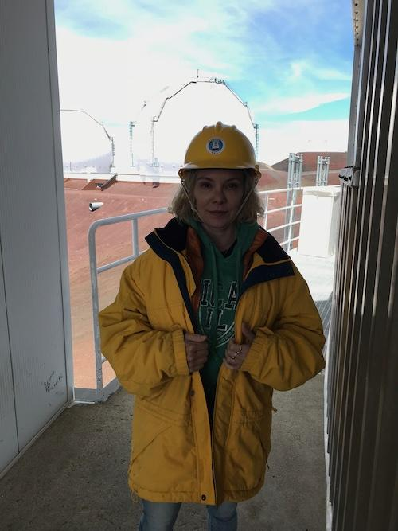
Team Altair
Bernie Boscoe, Southern Oregon University
Team Mentors :
Team Theme Song: New Order, Thieves like us remix (1987)
https://soundcloud.com/markaymufc/new-order-thieves-like-us-mk-instrumental-cover-kleptomaniac-mix
Goals:
To add a module to an undergraduate Intro to Data Science course that demonstrates how to use Jupyter Notebooks in the cloud, with a large dataset, and if I can, GPUs to train an ML model that would not be possible to do without a GPU-enabled device. Outcomes would be an understanding of accessing cloud interfaces, basic terminal commands, an overview of the Jupyter notebook as both a local and cloud tool, and if possible, how to test if GPUs are being seen.
What I need help with: what resources have Jupyter notebooks with GPU option? How can we all share a space, for example for 25 students? How do I handle accounts? How can we load/make available a dataset for them to access?
https://github.com/bboscoe/gateways23

